Slide 1

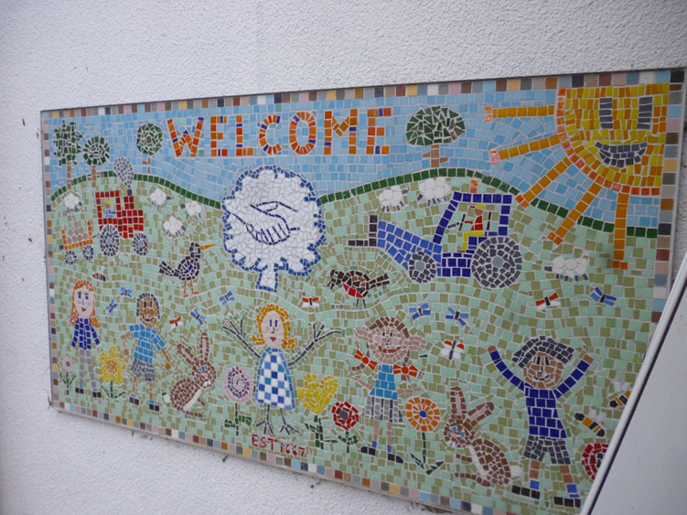
Welcome to Brinkworth Earl Danby’s

Slide 2
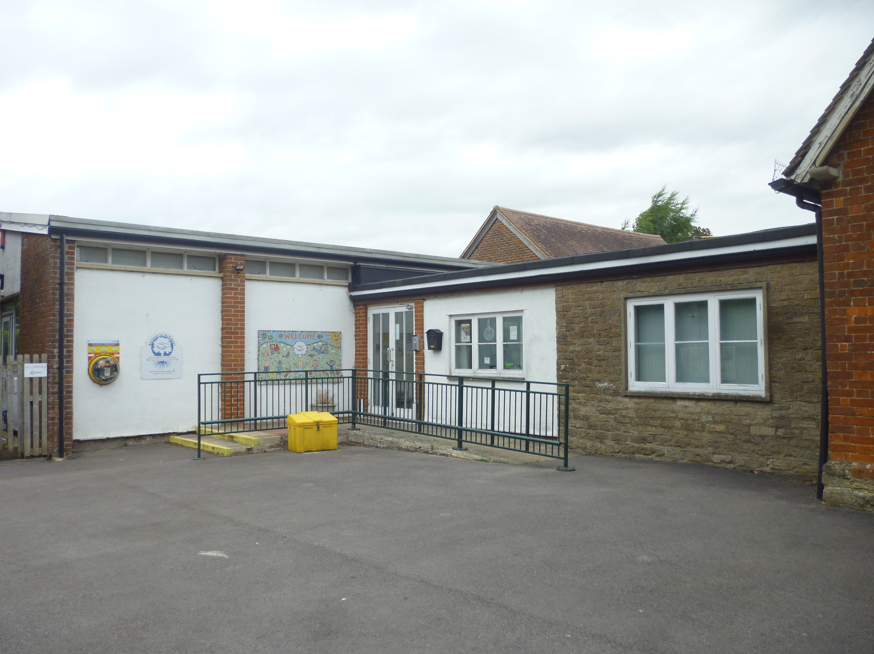
Lower site

Slide 3
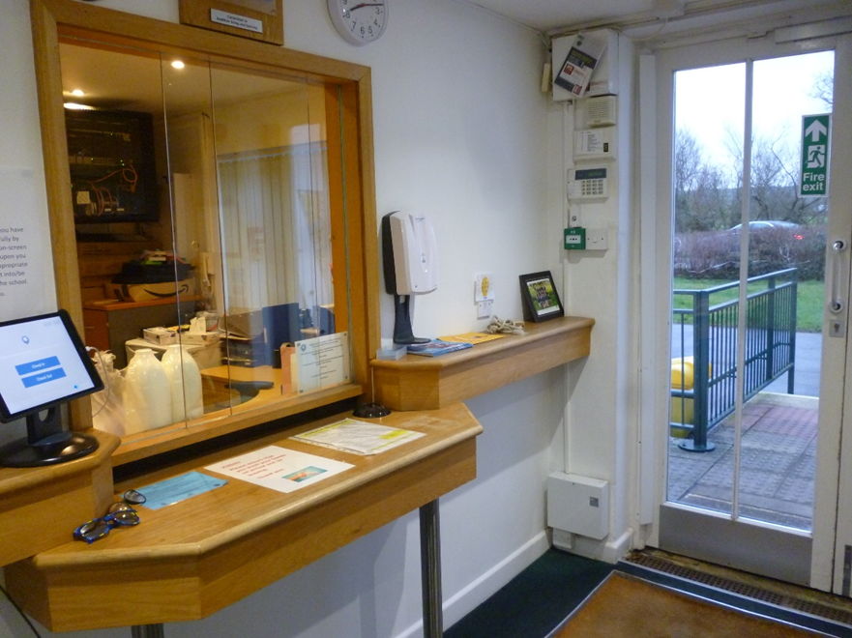
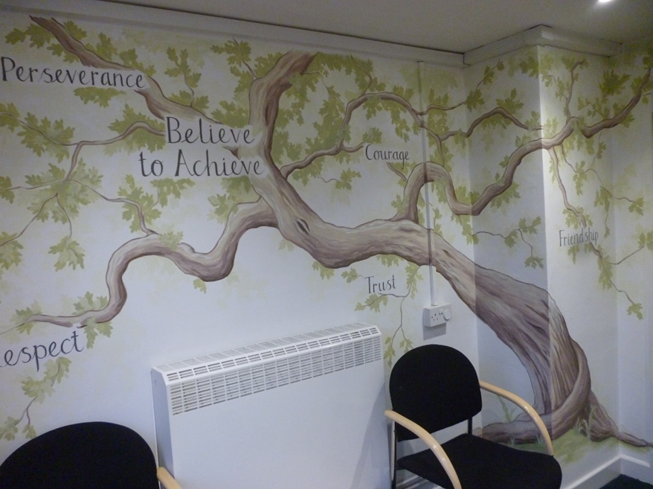
Lower site – Our main entrance and school office.

Slide 4
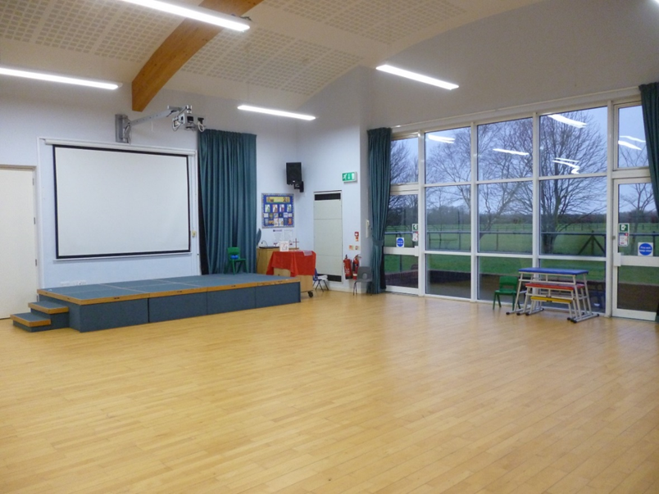
Our school hall where we come together for our collective worship, lunch and other fun events.

Slide 5
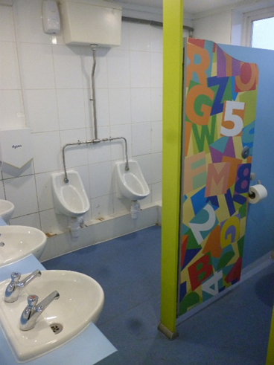
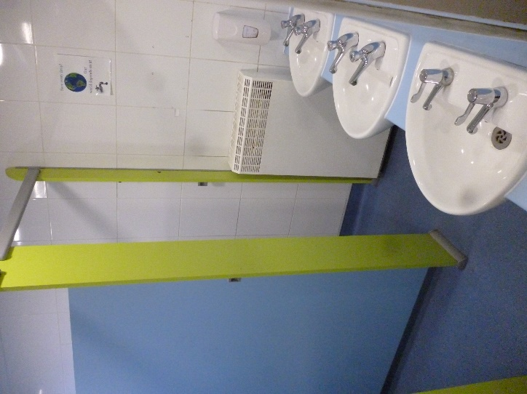
Girls and boys toilets

Slide 6
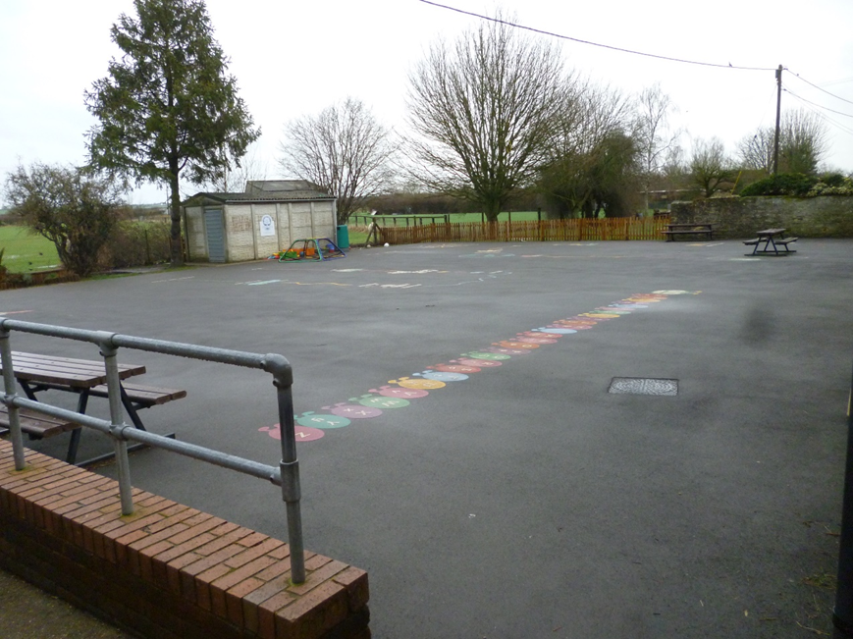
Our main playground

Slide 7
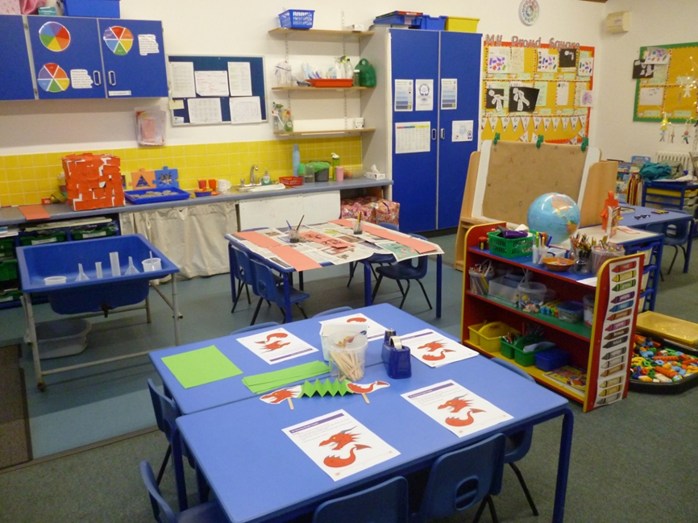
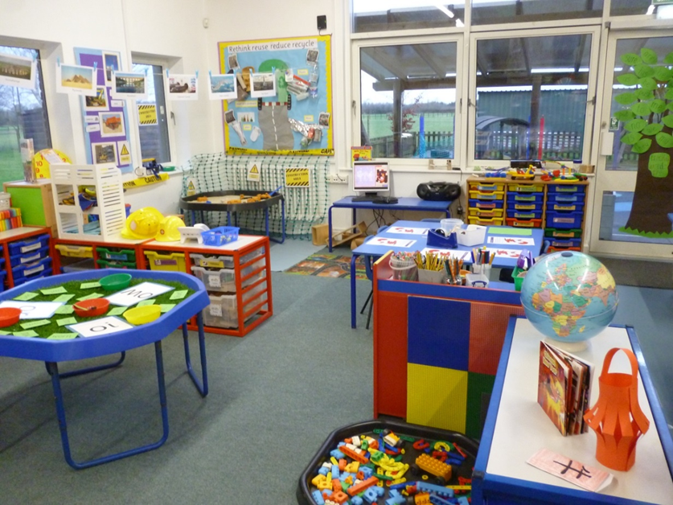
Beech class where we have lots of fun learning through play.

Slide 8
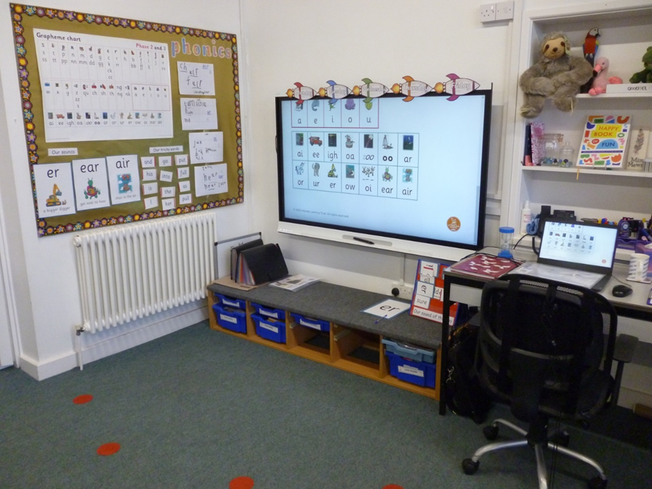
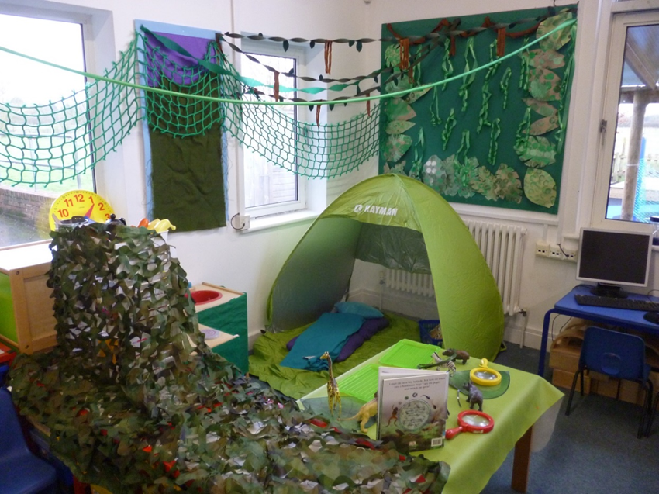
Our home corner which changes every term. This is our jungle camp site for our ‘All creatures great and small’ theme.
Our carpet area is where we come together for stories, phonics and sharing time.

Slide 9
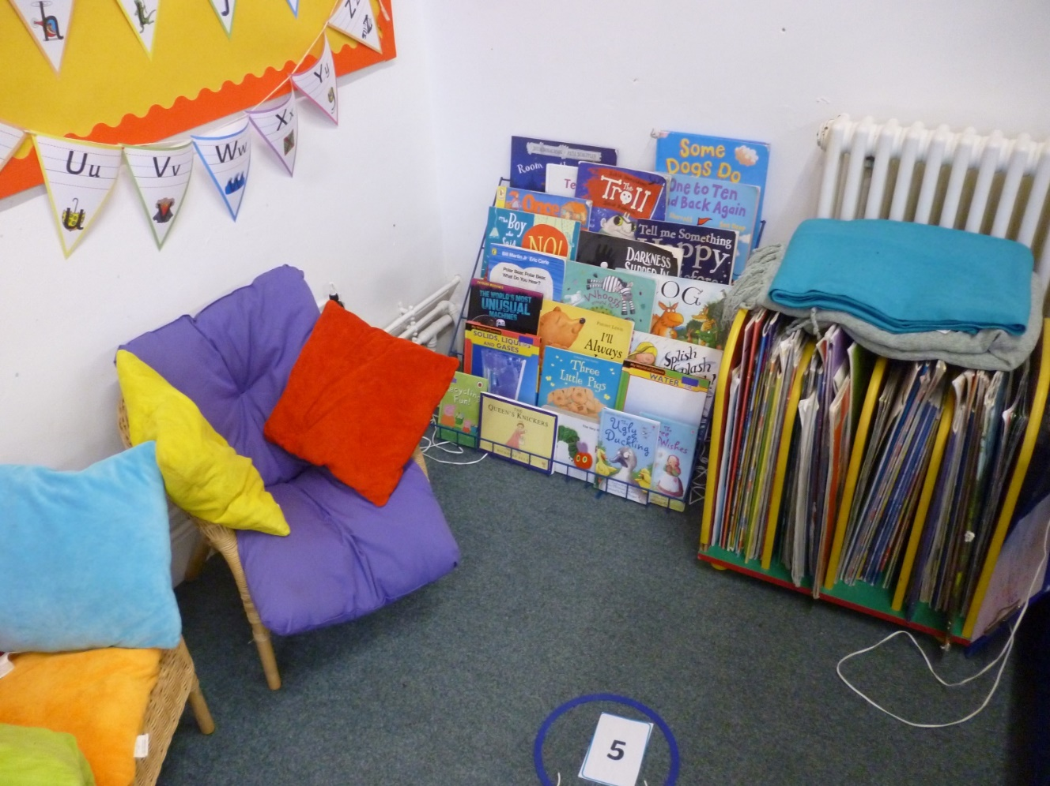
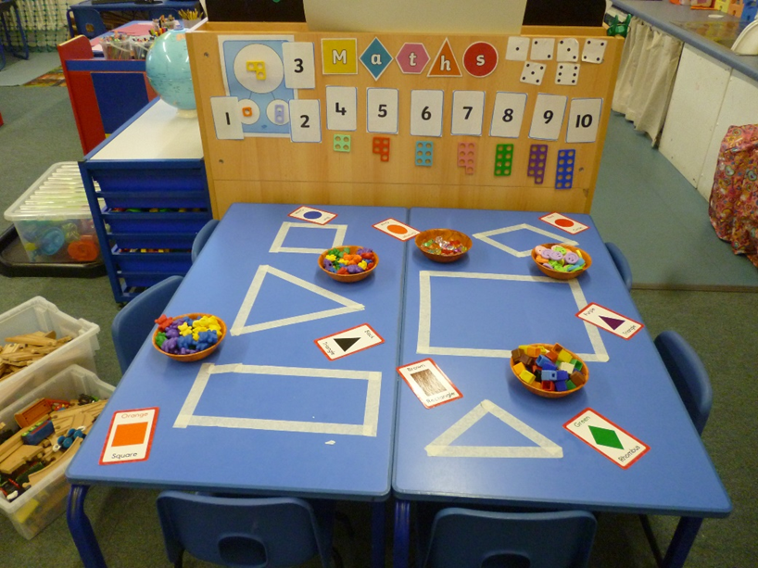
Our Maths table
Our book corner

Slide 10
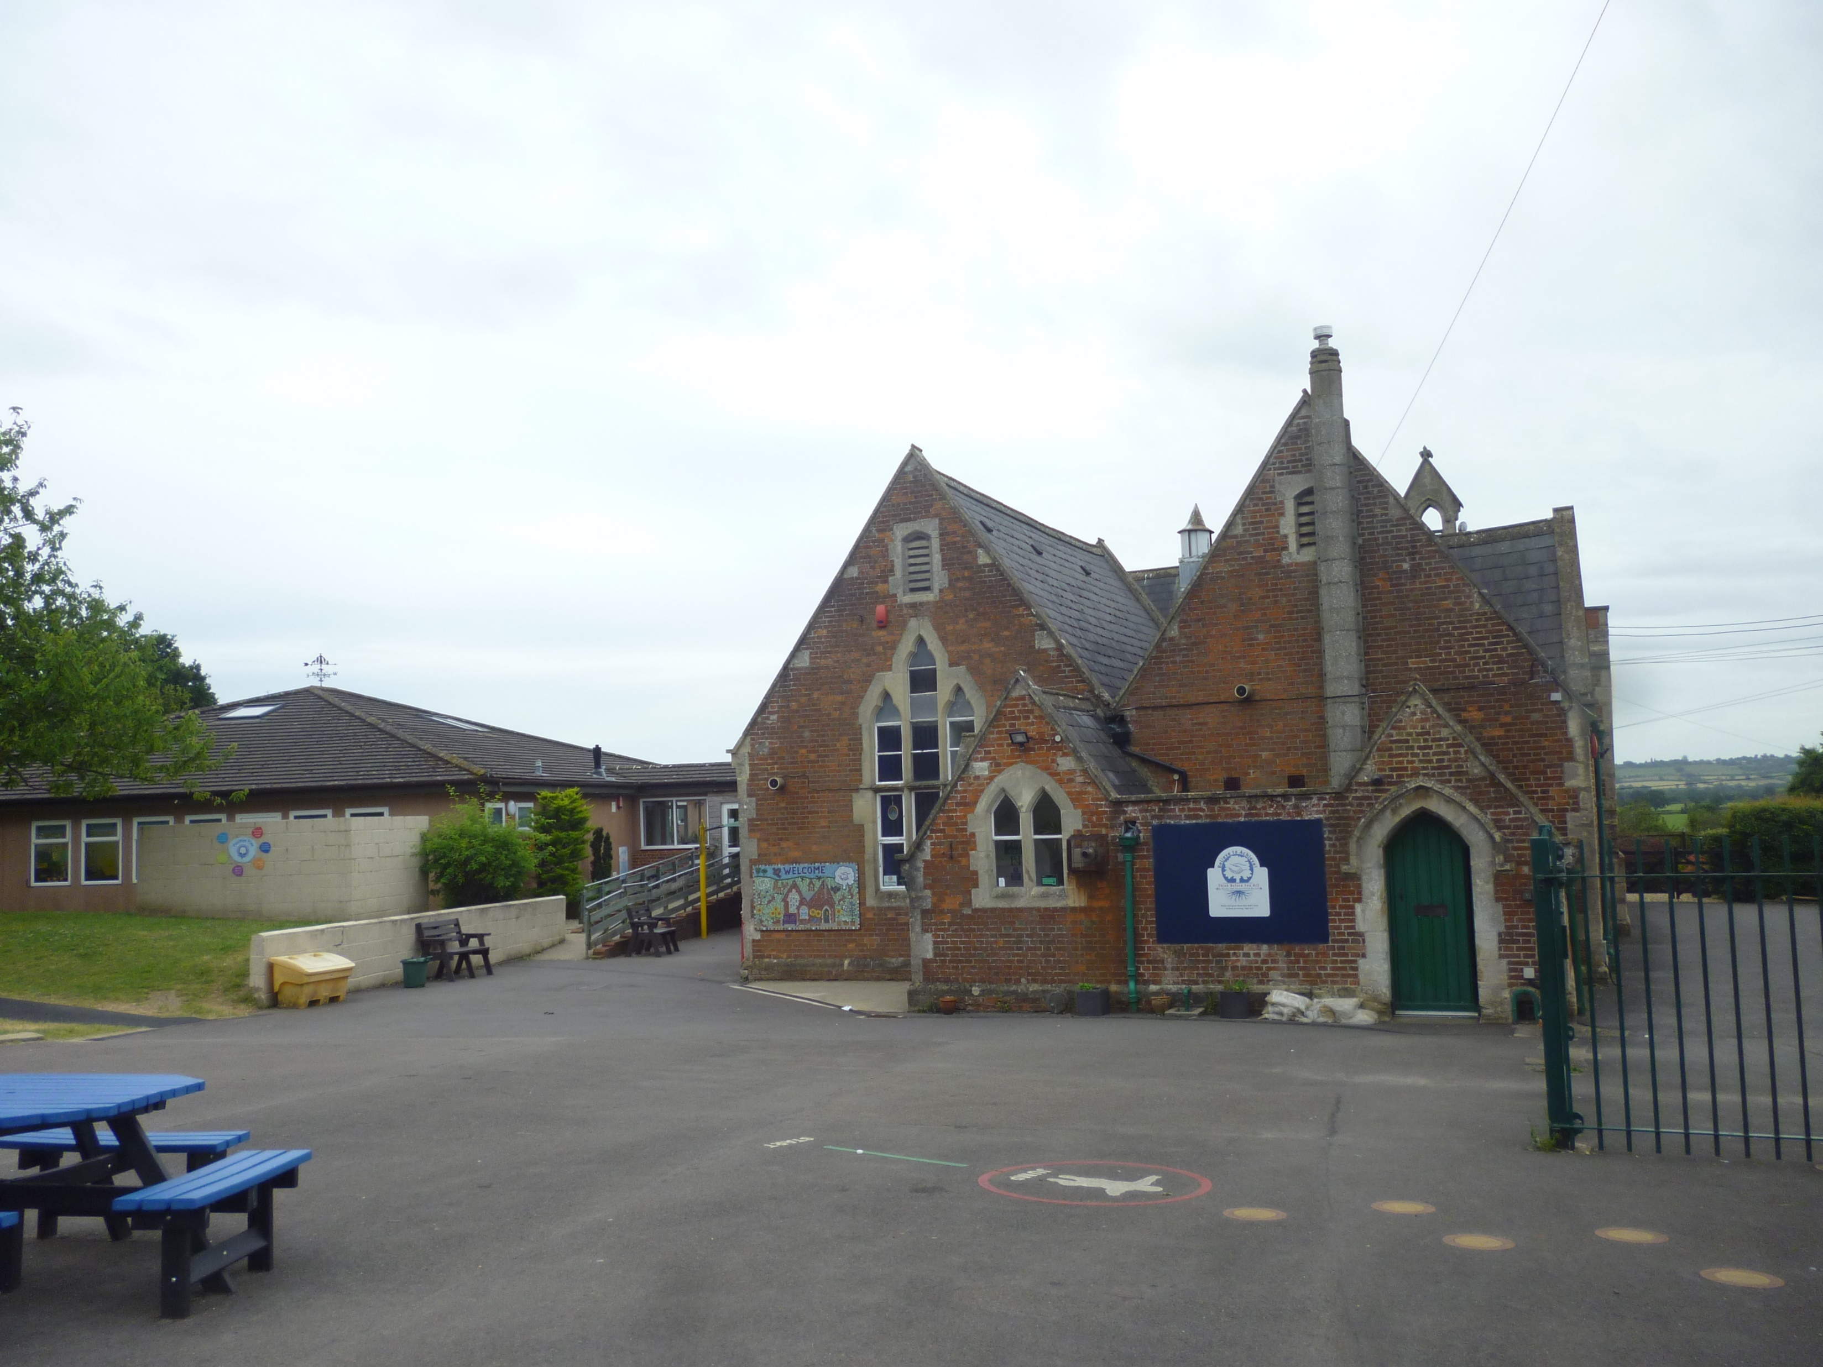
Upper site
To mark special events we bring both school sites together for our ‘whole school days.’

Slide 11
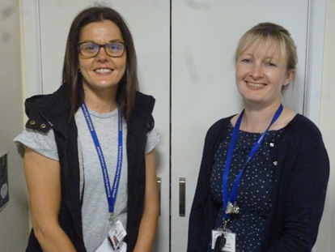
Thank you for coming to visit us this term.
We hope you have a lovely summer and we will see you in September.
We can’t wait!
Miss Mewis & Mrs Howes

