Slide 1


Morfa Bay Year 6 Residential
13rd – 16th June 2025

Slide 2
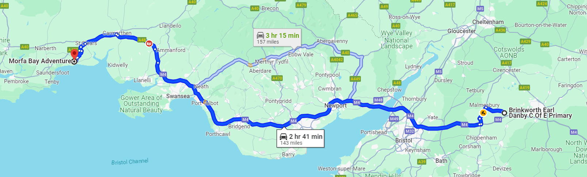
Early Start, drop off 8:15am from Brinkworth Earl Danby’s upper site, then onto Morfa Bay.
Each child will need a packed lunch for the first day and come dressed ready for their first activity.
We will be stopping in Swansea service station on the way.
We aim to arrive at 10:30am

Slide 3
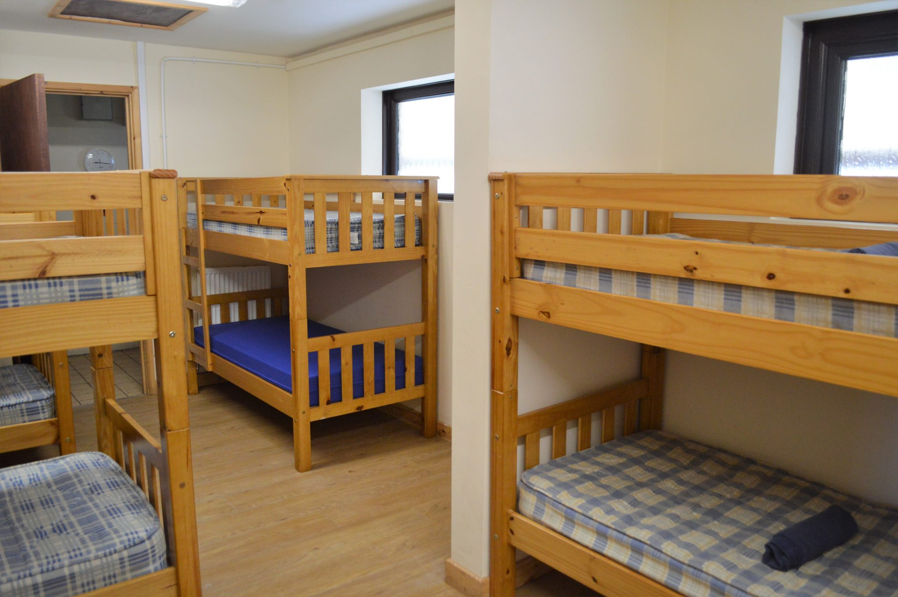
Accommodation
Luckington and BED are dealt with as one school
Bunk lodges
Shared (single gender dorms)
Night time toilets
Separate showering facilities
Other schools may be onsite at the
same time
Separate accommodation block,
meal times and activity schedule to other school

Slide 4
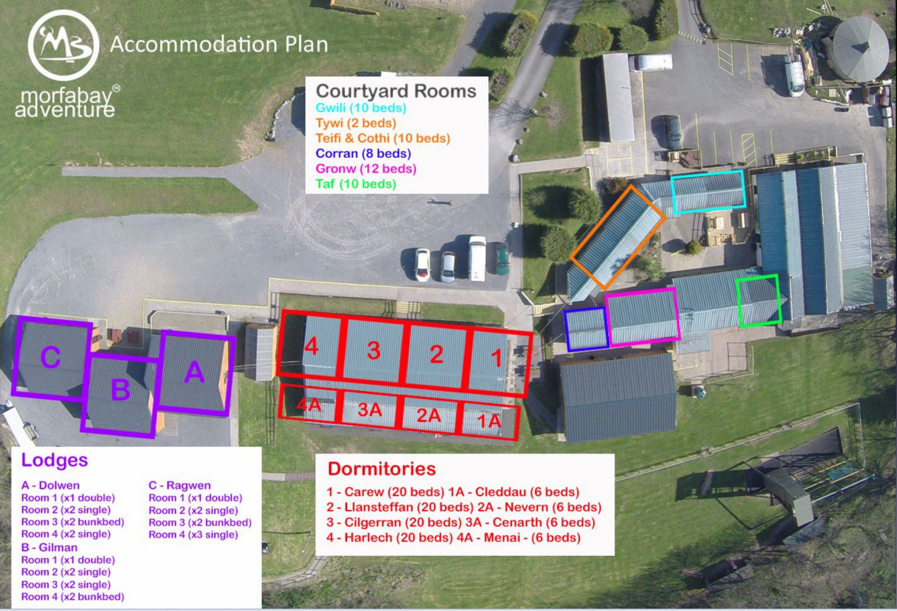
Outdoor bar-B-Q area
Games room with board games, cards and sofas.
Canteen
Staff accommodation
Drying Room

Slide 5
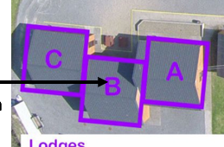
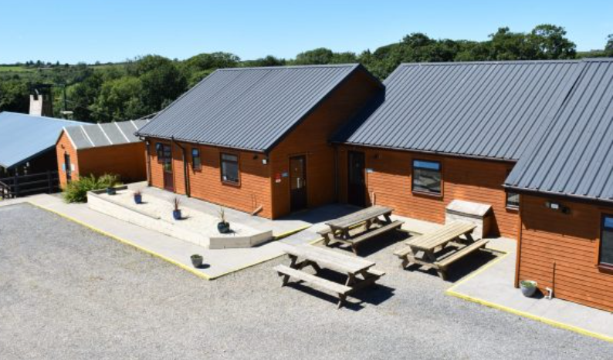

Slide 6
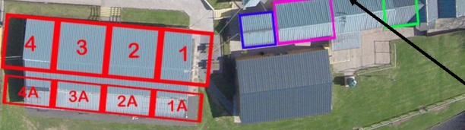
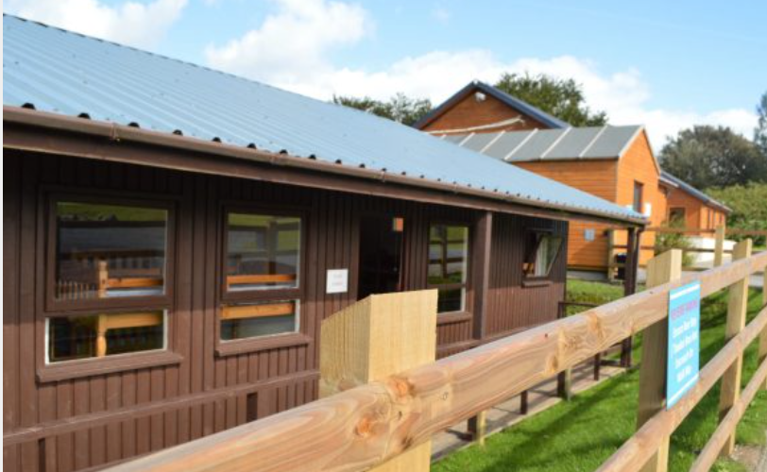

Slide 7
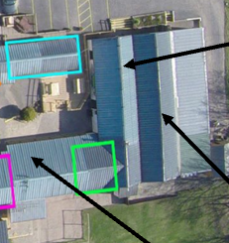
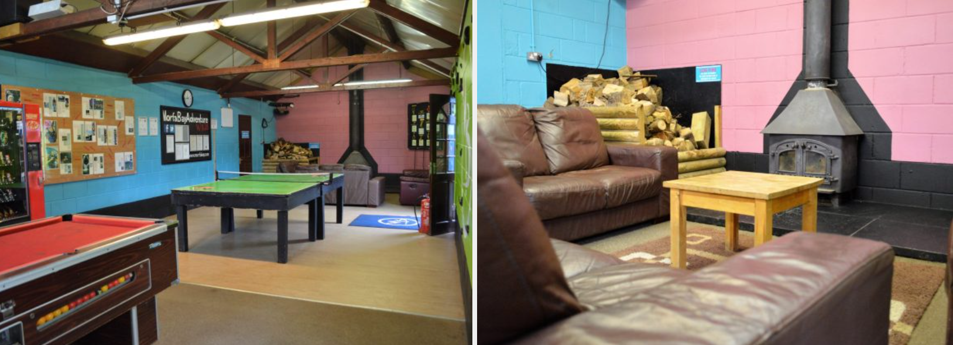

Slide 8
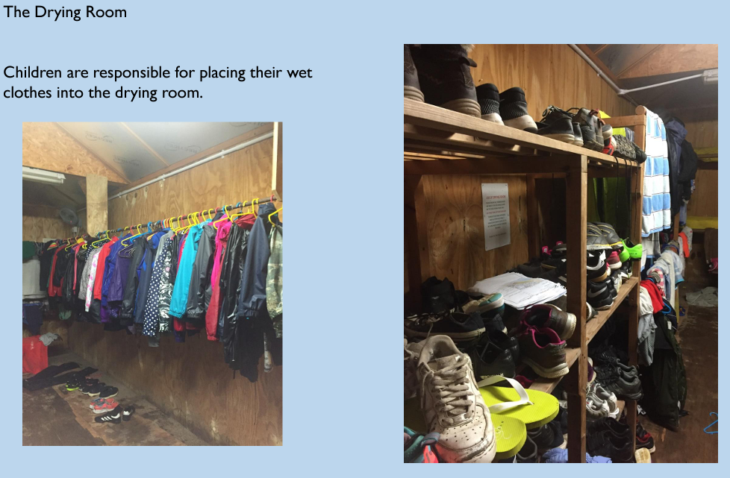

Slide 9
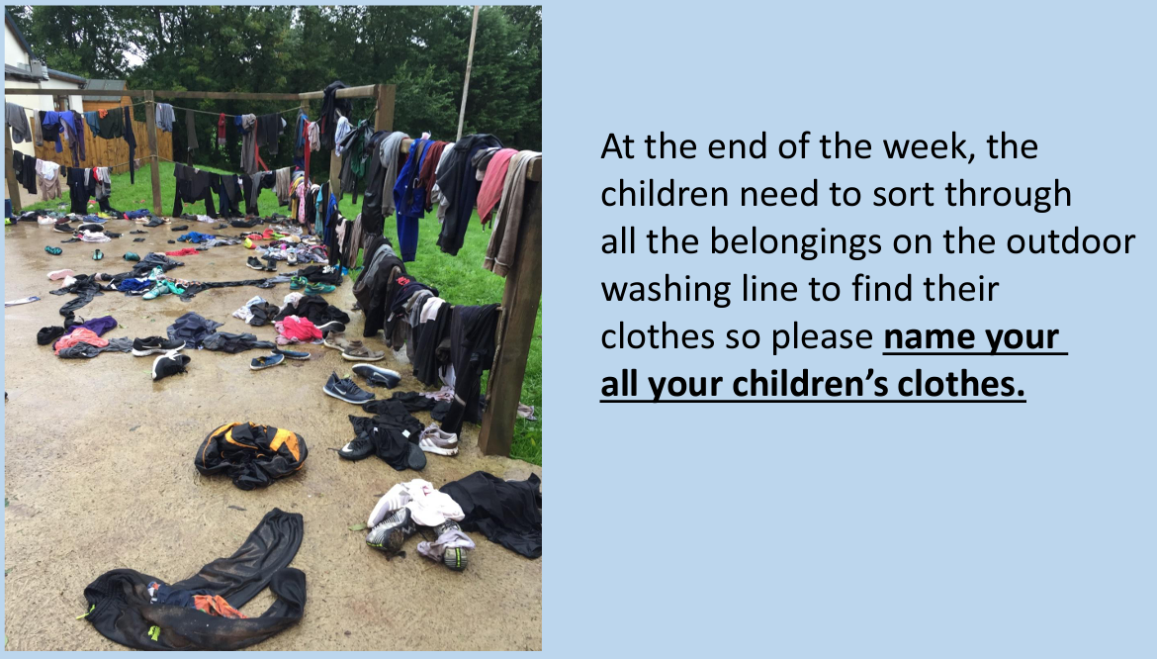

Slide 10
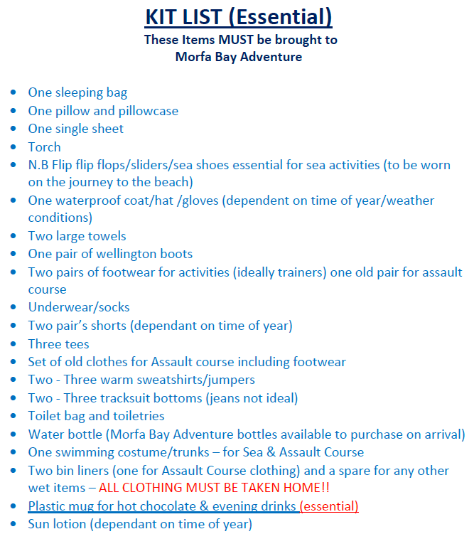
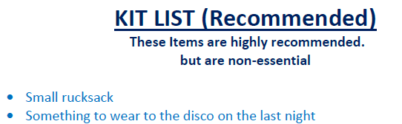

Slide 11
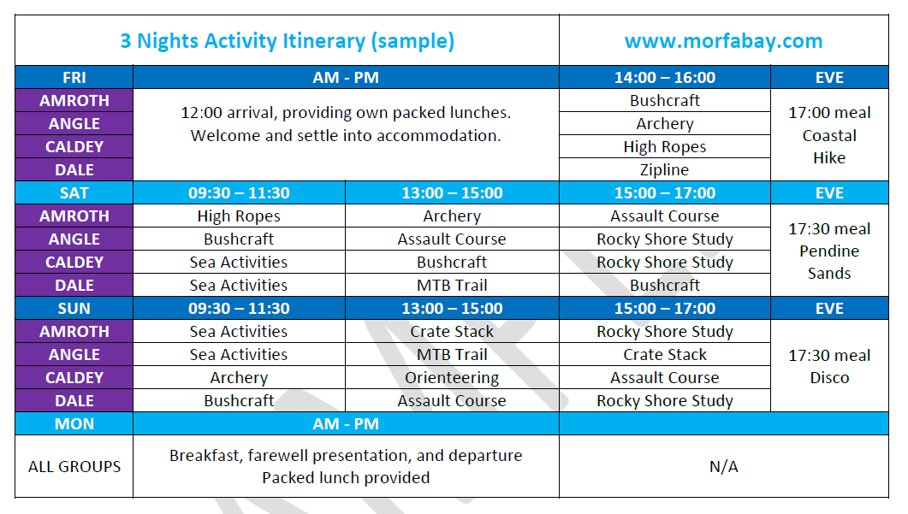

Slide 12
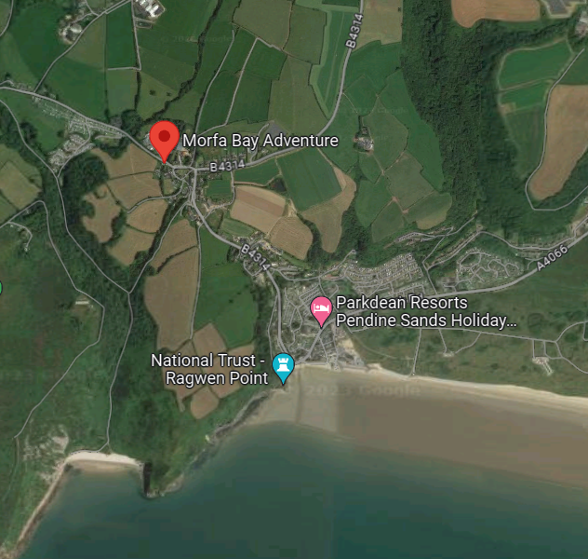

Slide 13
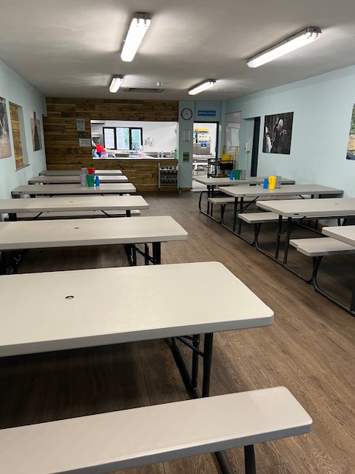
All children eat together.
All needs will catered for!

Slide 14
Any Questions…

